Slide 1
Colorado State University
Fort Collins, CO
Analysis of
Various
Cannabinoid Containing Materials
A Gas Chromatographic Investigation
Joseph DiVerdi
Department of Chemistry
Colorado State University
Fort Collins, CO USA
February 2024

Slide 2
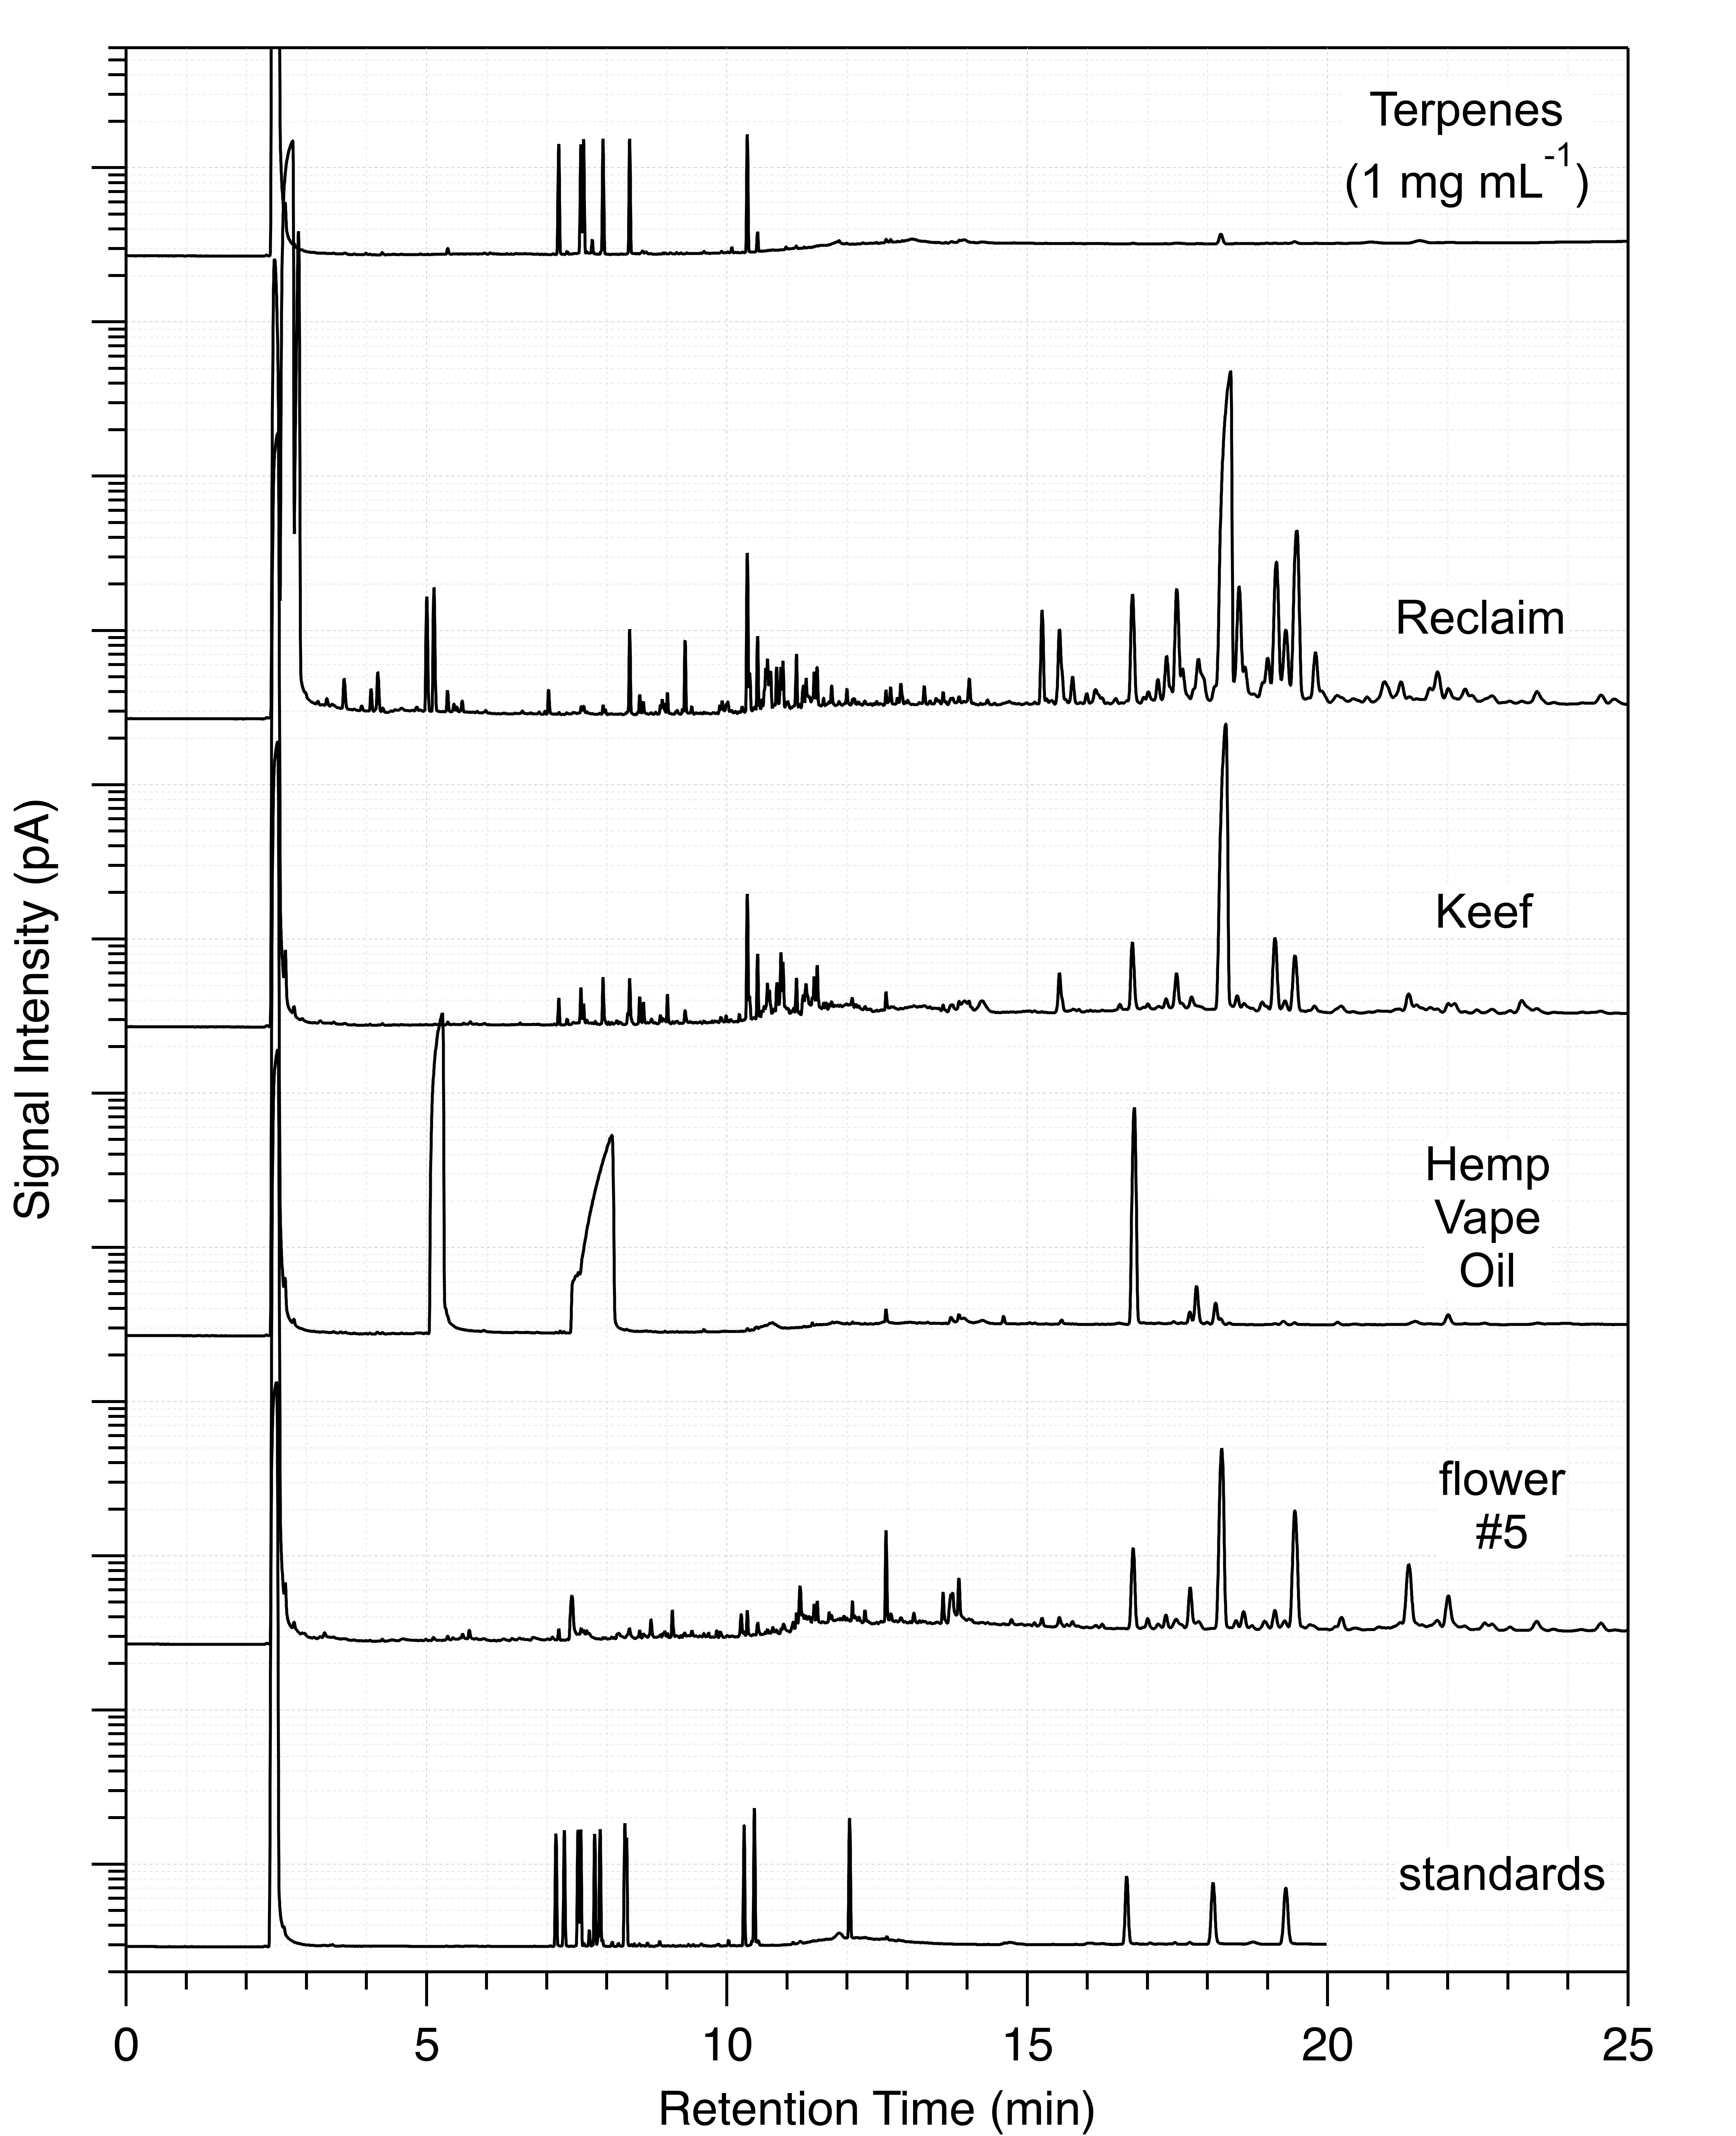
Colorado State University
Fort Collins, CO
Full Chromatograms of all Samples

Slide 3
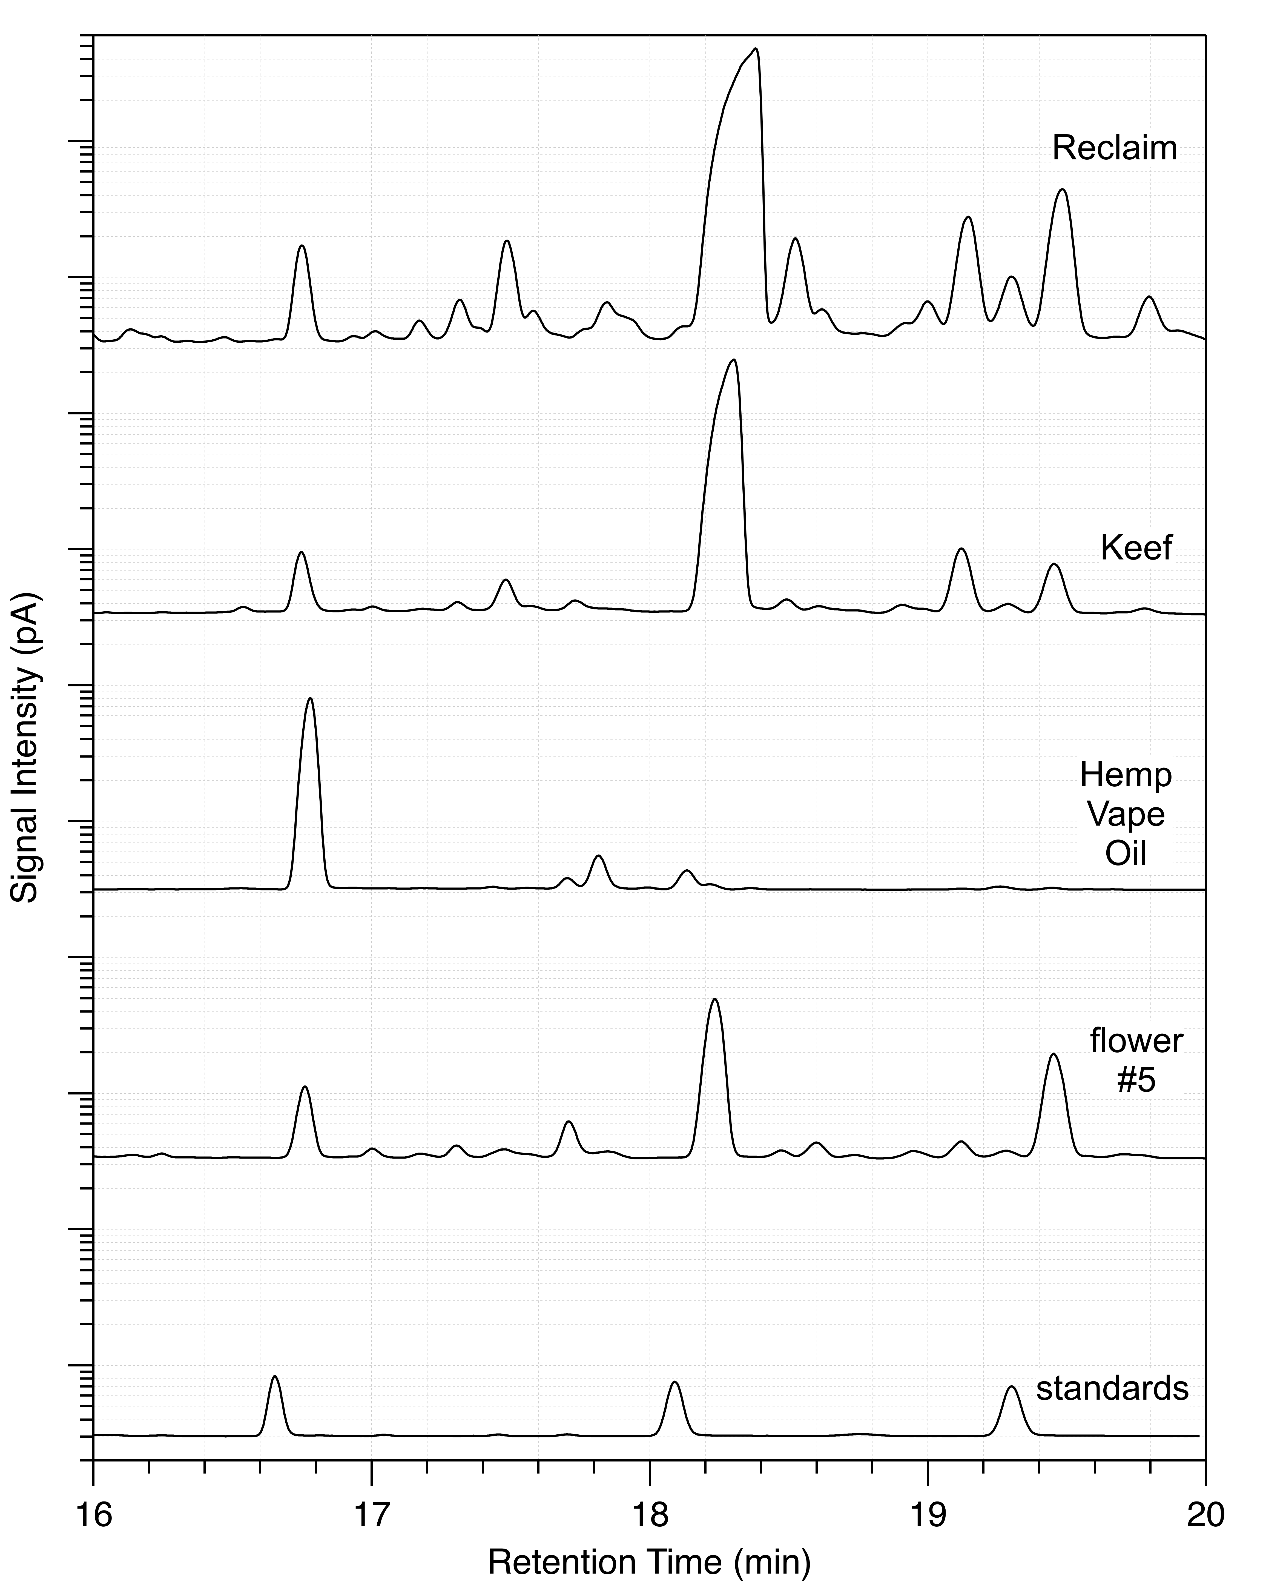
Colorado State University
Fort Collins, CO
Expanded Cannabinoid Region

Slide 4
Colorado State University
Fort Collins, CO
The Need for Good Annotation

Slide 5
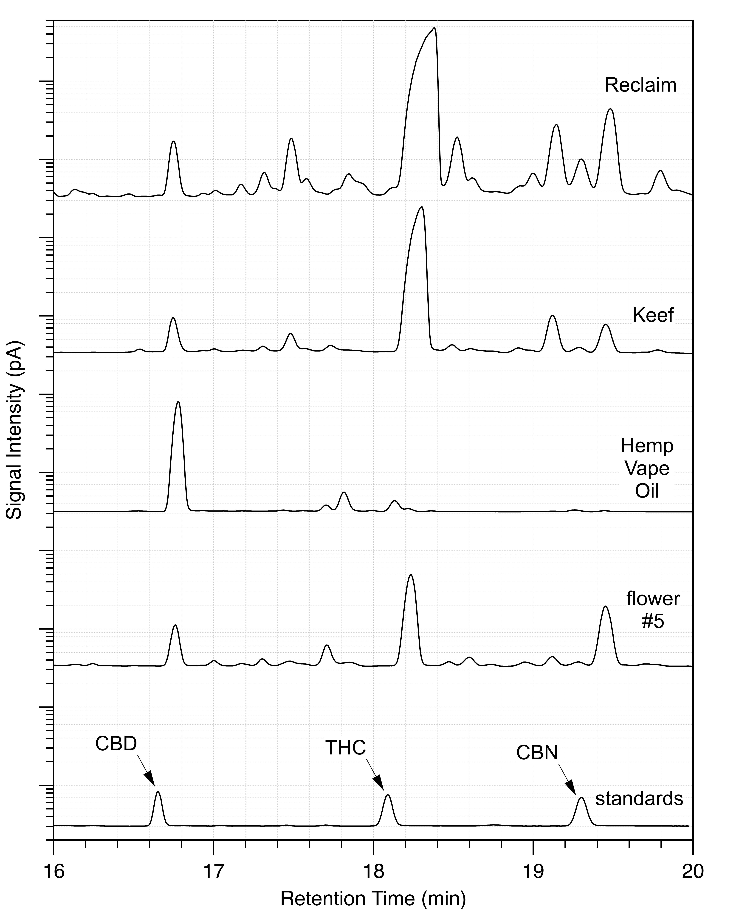
Colorado State University
Fort Collins, CO
Now We Can Analyze

Slide 6
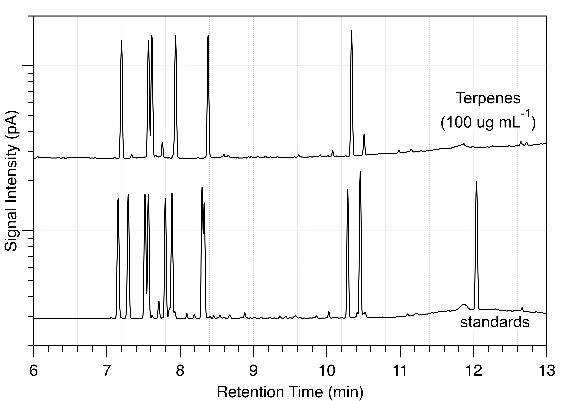
Colorado State University
Fort Collins, CO
Expanded Terpene Region

Slide 7
Colorado State University
Fort Collins, CO
More Annotation

Slide 8
Colorado State University
Fort Collins, CO
To Be Performed

Slide 9
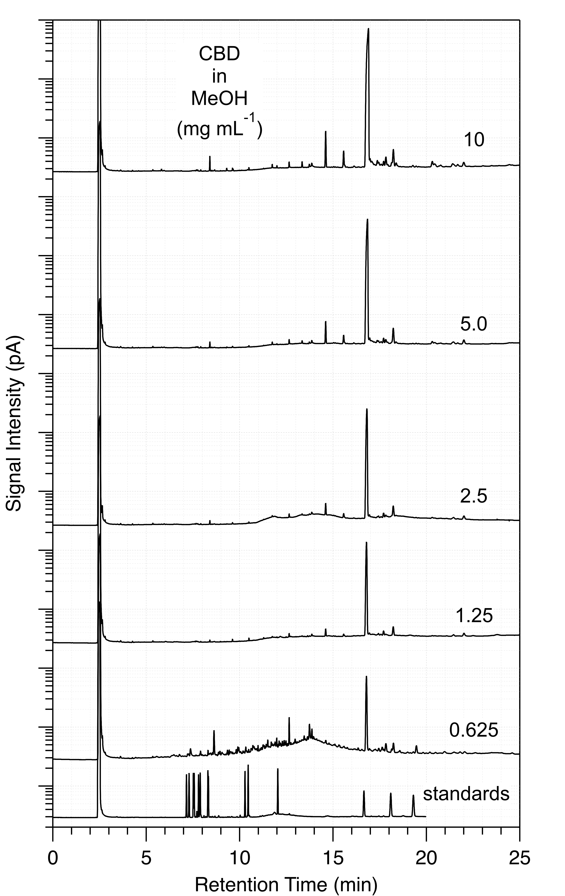
Colorado State University
Fort Collins, CO
CBD Concentration Raw Data

Slide 10
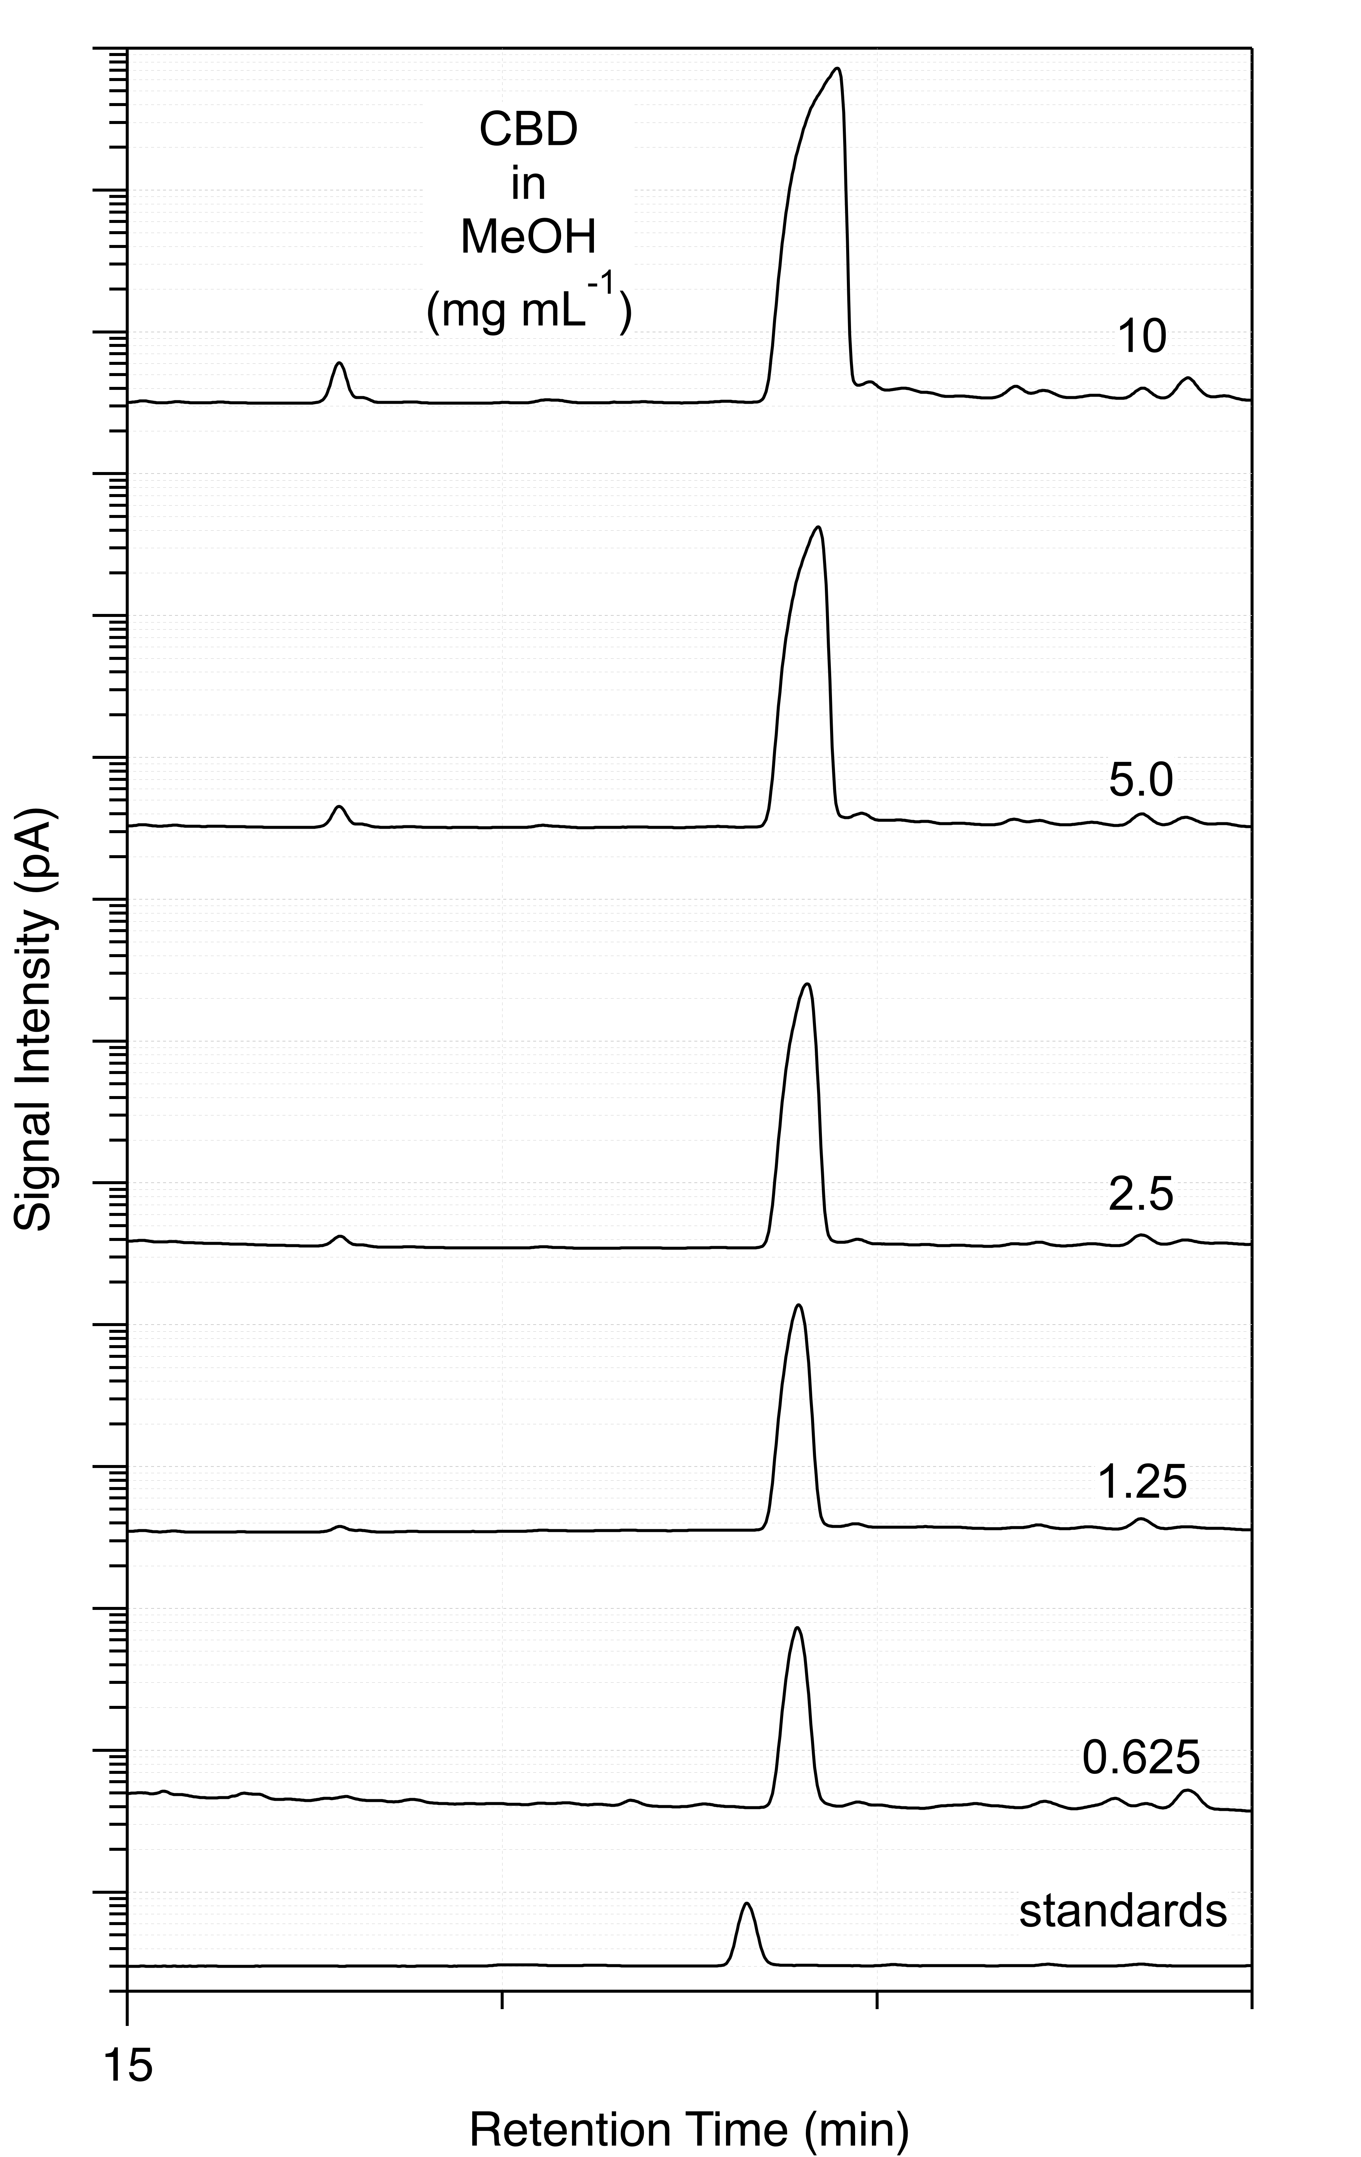
Colorado State University
Fort Collins, CO
CBD Region Expanded

Slide 11
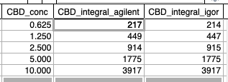

Colorado State University
Fort Collins, CO
Agilent – Igor Comparison & Conversion

Slide 12
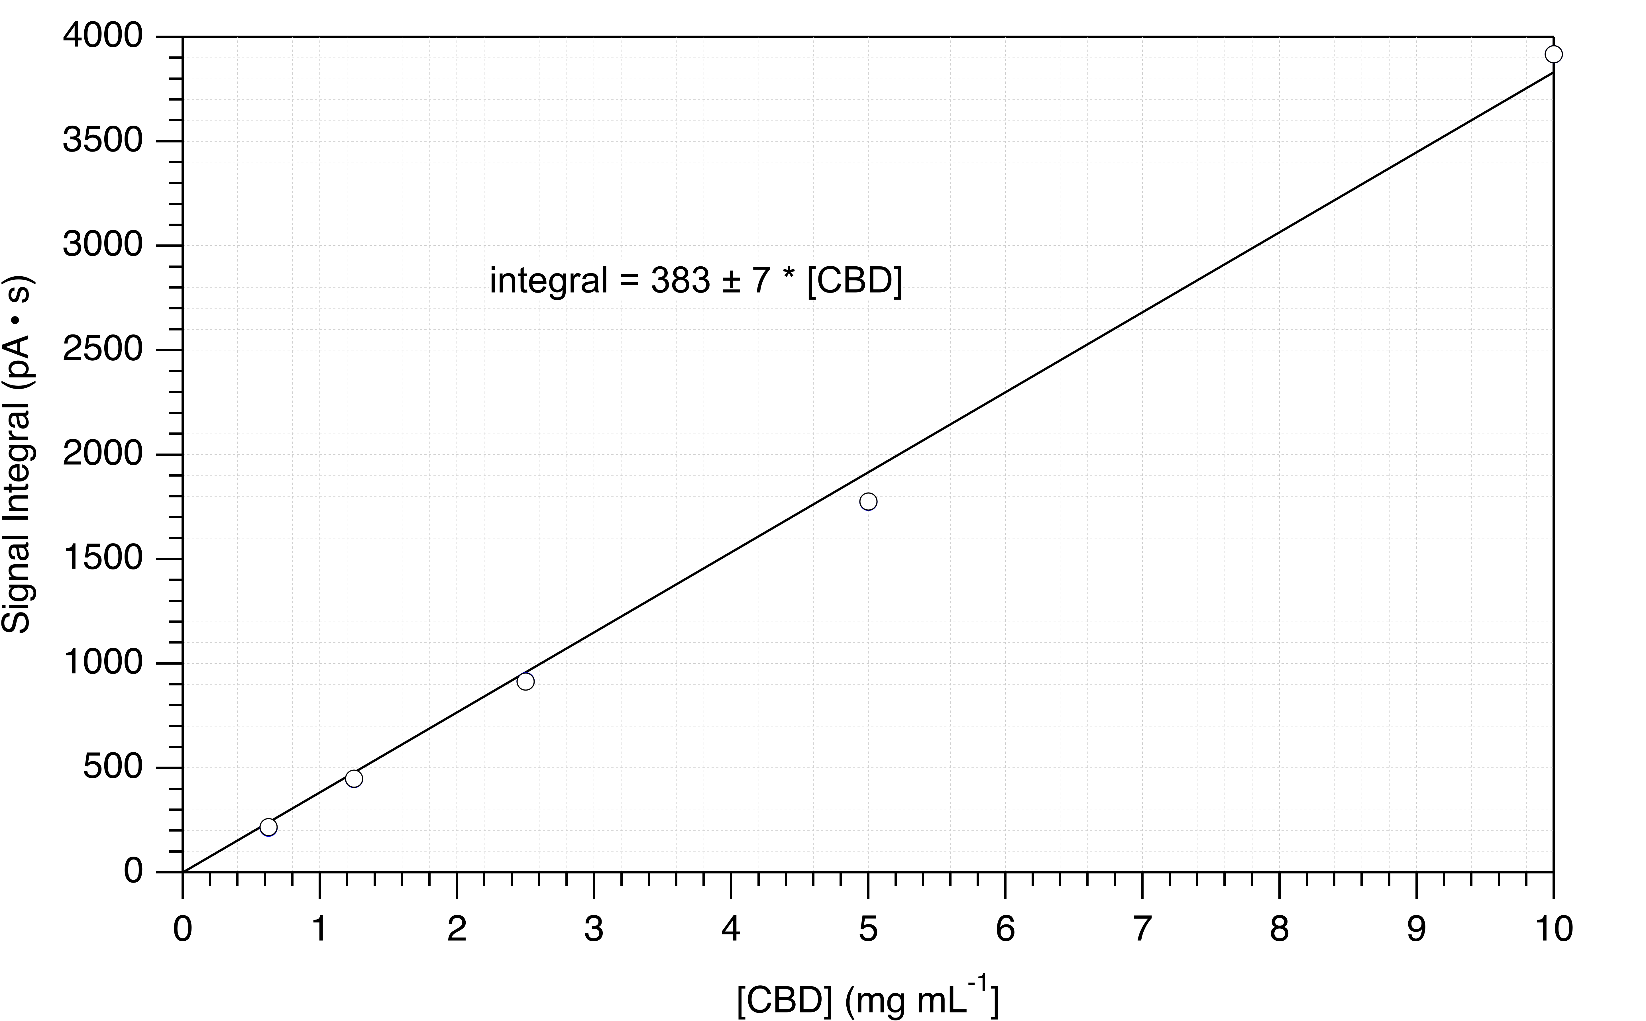
Colorado State University
Fort Collins, CO
“Beers Law”

Slide 13
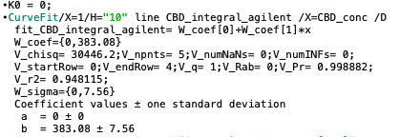
Colorado State University
Fort Collins, CO
Igor Analysis Results

Slide 14
Acknowledgements
Colorado State University
Fort Collins, CO
Thanks to the students of CHEM 442 (Spring 2024)
For Experimental Assistance

